Slide 1
Activity 4: FEATURE EXTRACTION FROM IMAGES USING IMAGEJ
Genesis Vertudez – 202003099
App Physics 157 - Computational Analysis and Modeling in Physics
Submitted to Dr. Maricor Soriano; Mx. Rene Principe Jr.

Slide 2
OBJECTIVES
Use ImageJ to manipulate images and extract their features
Apply threshold to grayscale histogram to separate objects from background

Slide 3
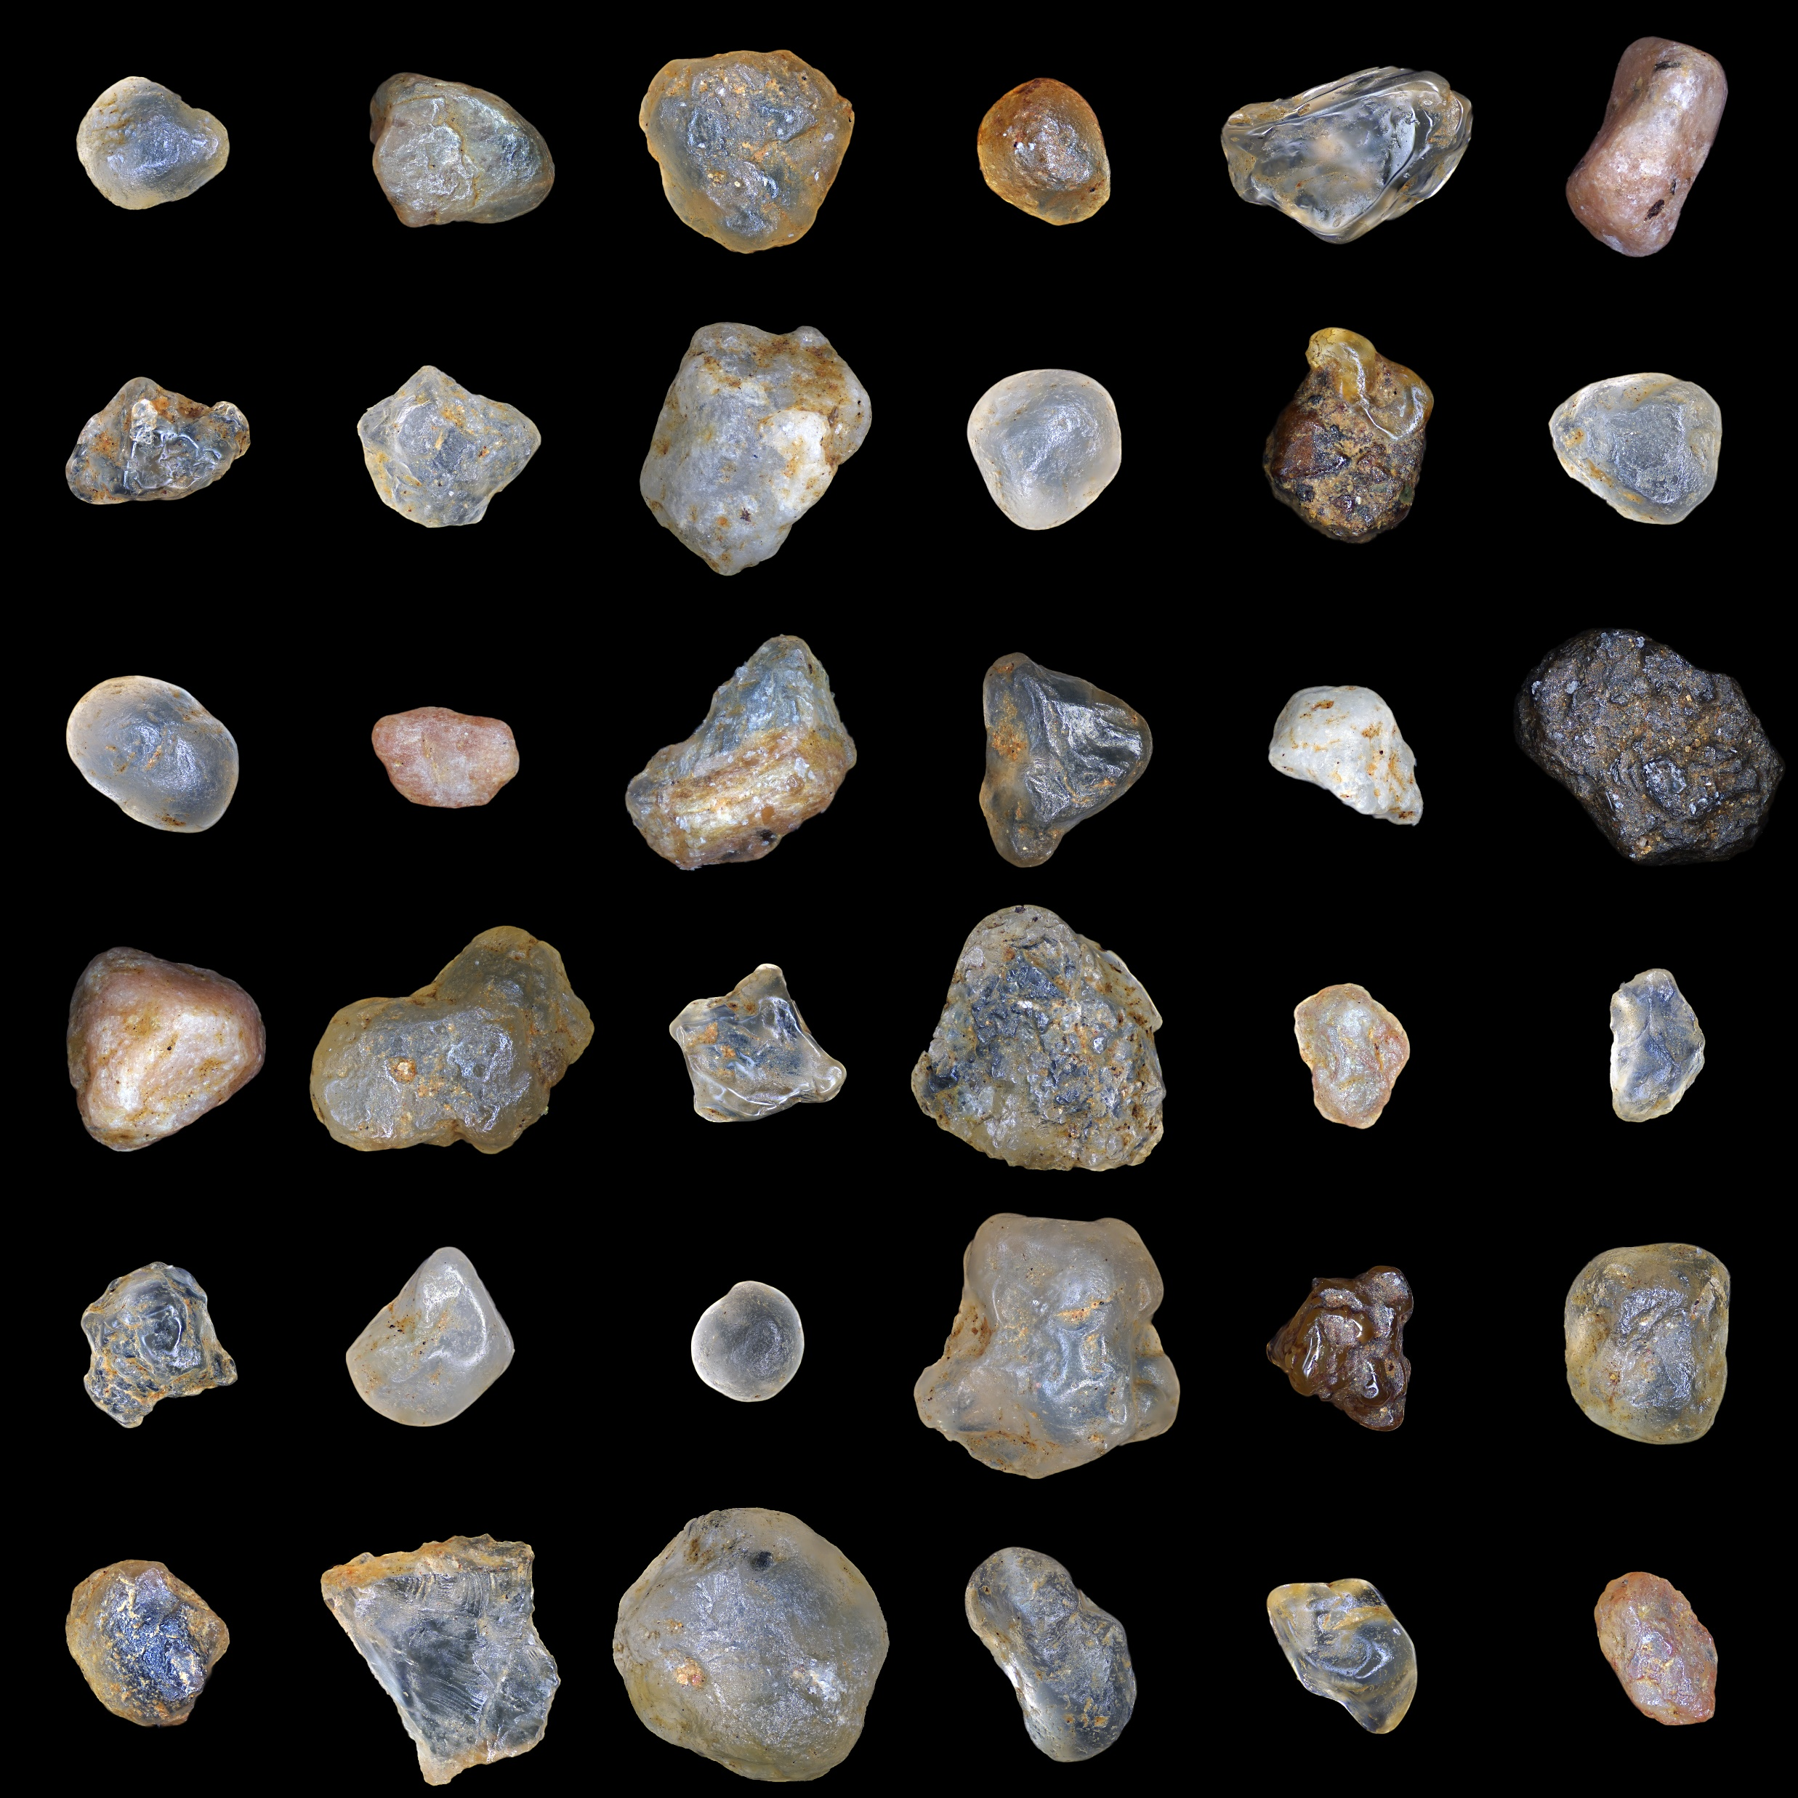
RESULTS & ANALYSIS
Image of sand particles
Files: https://github.com/genvert/AP_157_FX-2_Vertudez/tree/main/Activity%204

Slide 4
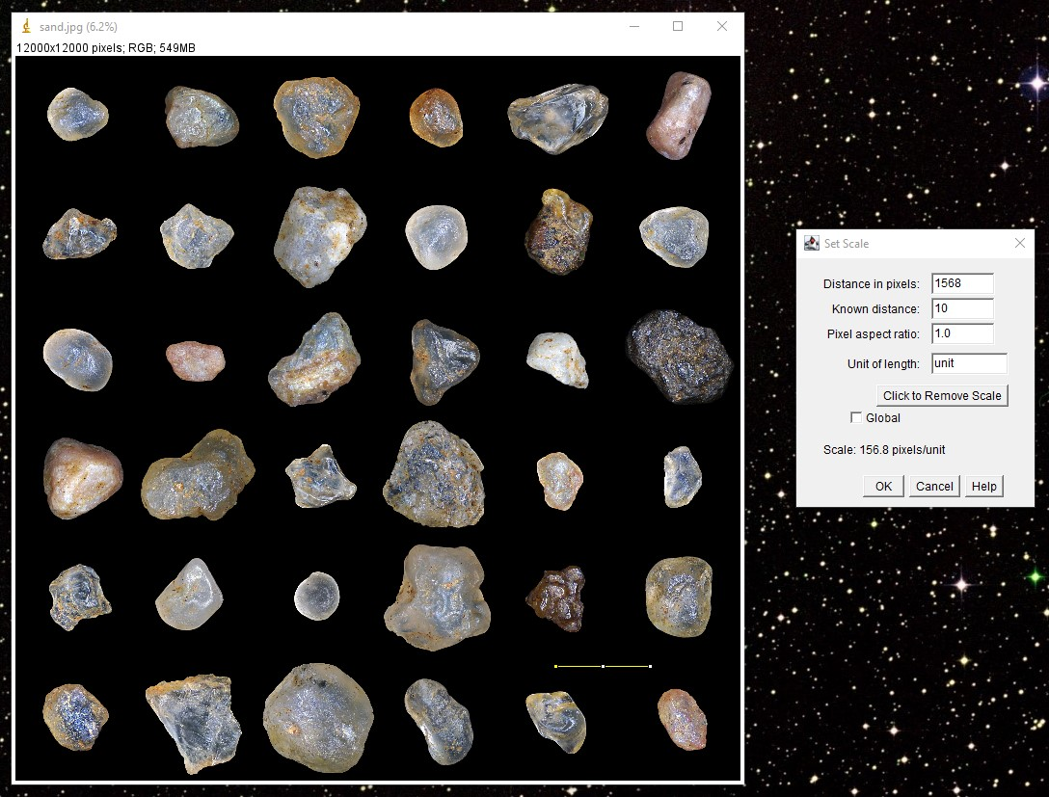
RESULTS & ANALYSIS
Setting scale
I just set an arbitrary scale as instructed. I used 10 units for about the same distance in the cell example.
Files: https://github.com/genvert/AP_157_FX-2_Vertudez/tree/main/Activity%204

Slide 5
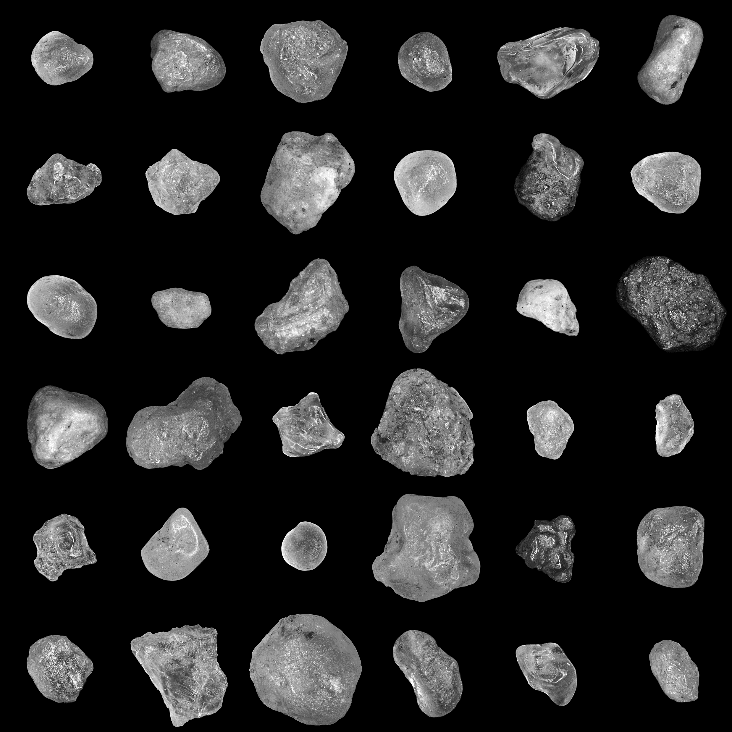
RESULTS & ANALYSIS
Converting to 8-bit
Applying threshold only works on grayscale images, so we convert it first.
Files: https://github.com/genvert/AP_157_FX-2_Vertudez/tree/main/Activity%204

Slide 6
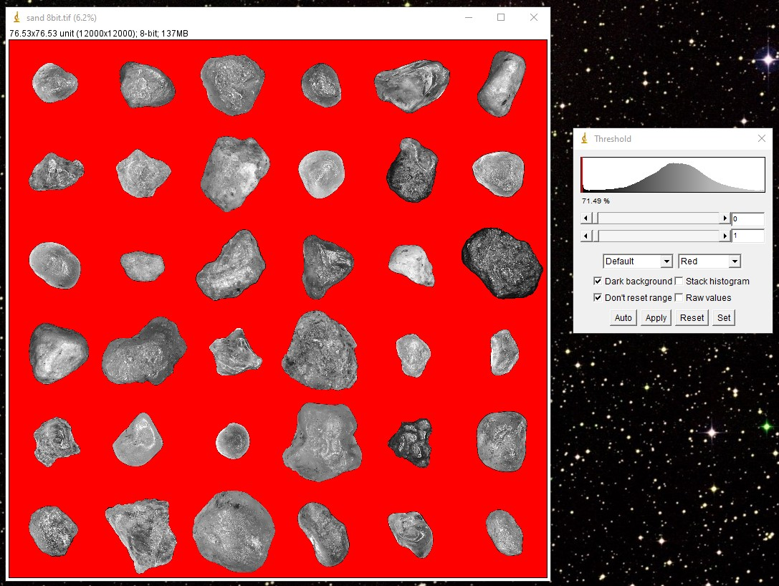
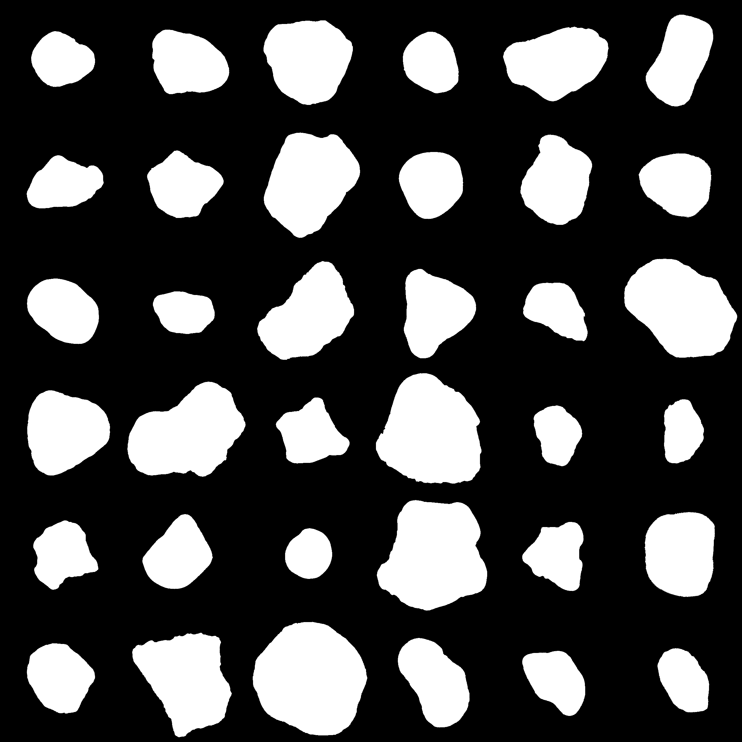
RESULTS & ANALYSIS
Applying threshold and binarizing
Since the background is black, it is easy to pick it out the histogram.
The image is then binarized to make sure that there are only two values for easier extraction of geometric features.
Files: https://github.com/genvert/AP_157_FX-2_Vertudez/tree/main/Activity%204

Slide 7
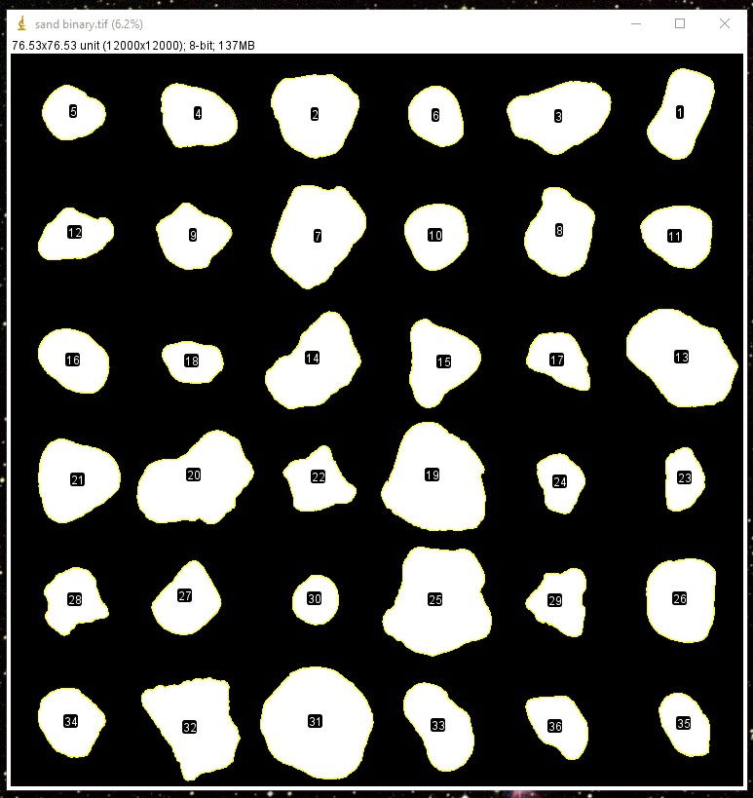
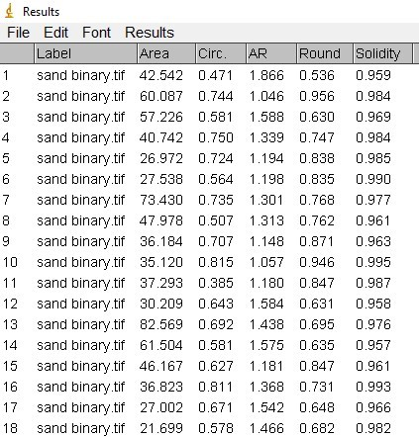
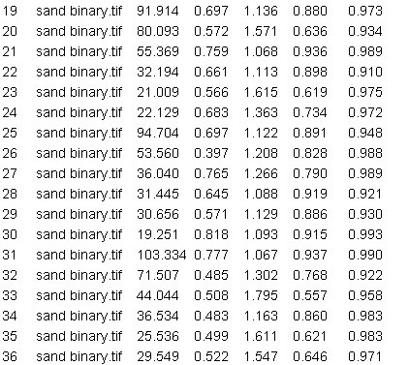
RESULTS & ANALYSIS
Analyze particles results
Files: https://github.com/genvert/AP_157_FX-2_Vertudez/tree/main/Activity%204

Slide 8
REFLECTION
This activity was straightforward so I was able to follow it easily.
It is fun to recognize and understand the functions of different options in ImageJ based on our fundamental understandings of image processing. It is cool to know that you can do these manually with coding without the app.
I am grateful for this no-coding exercise. This is a breather exercise because I have been overwhelmed by coding lately.

